Slide 1

Selective Object Recognition on Sight
Eye-Tracking and Keypoint Detection Models Using CNN Architecture
By Lee Santos

Slide 2
Introduction
Long-term goal
Develop application for portable hardware capable of tracking eye movement to selectively detect and recognize objects based on sight
Primary application considered is for use as an accessibility tool
Other applications:
Retail, Sales
Construction, Trades

Slide 3
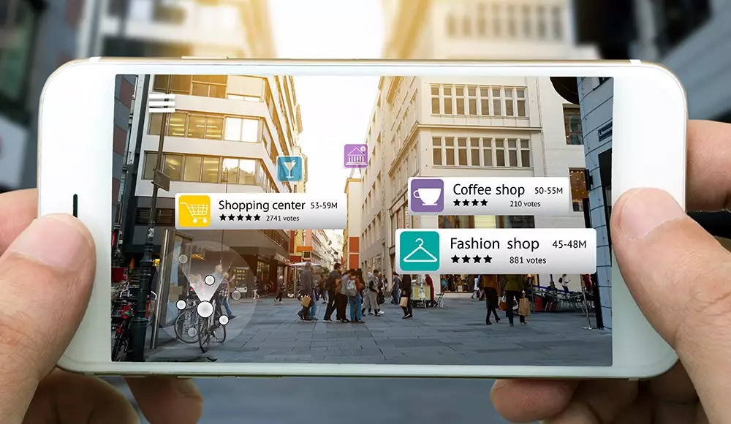
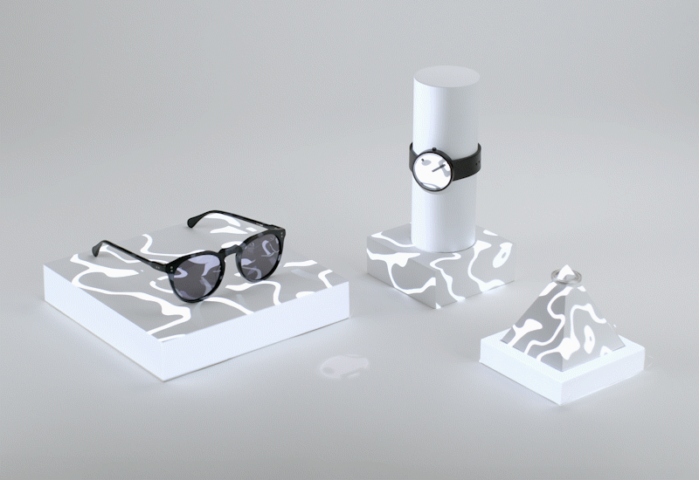


Solutions in Augmented Reality (AR)
Markerless AR
Location
GPS
Projection
Lightform mapping
Superimposition
Object detection to overlay
Marker-based AR
Anchor to identifier (e.g., QR, barcodes)

Slide 4
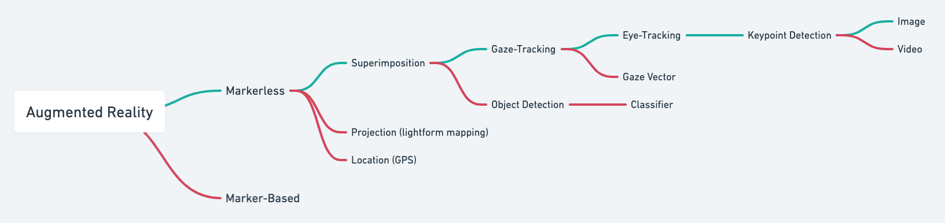
AR & Project Scope
Project is the sum of many small components
Subcomponent focus: keypoint detection
Use keypoint detection to track pupil location
Work towards real-time eye-tracking

Slide 5
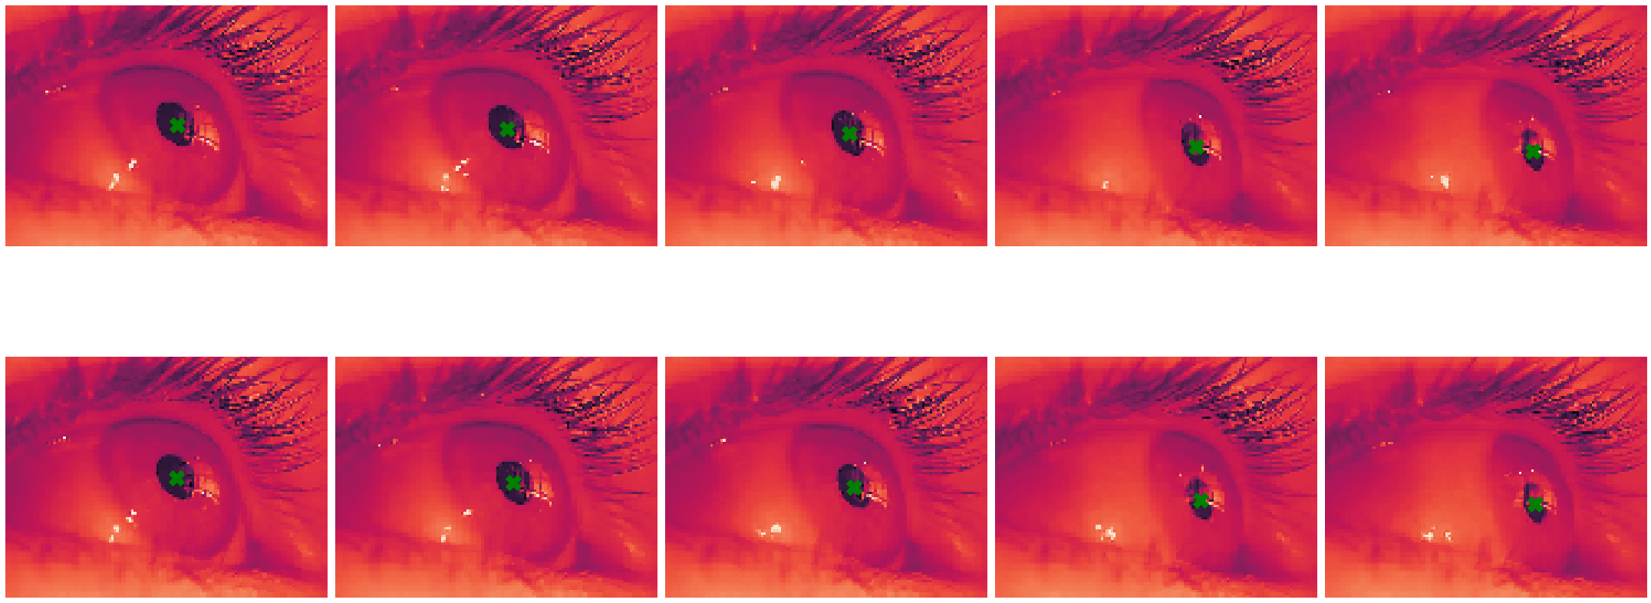


Keypoint Detection
Plotted sample of eye capture dataset with labeled keypoints in the x,y-coordinates
Keypoint marked with green ‘X’

Slide 6
1. Dataset Processing
Feature Engineering (Reductions)
Convert to grayscale colorspace (remove RGB dimension)
Image resizing / downsampling using OpenCV
640 x 480 → 128 x 96
Scaling keypoint labels to match new image coordinates
Scaling image pixel values using scikit’s standard scaler

Slide 7
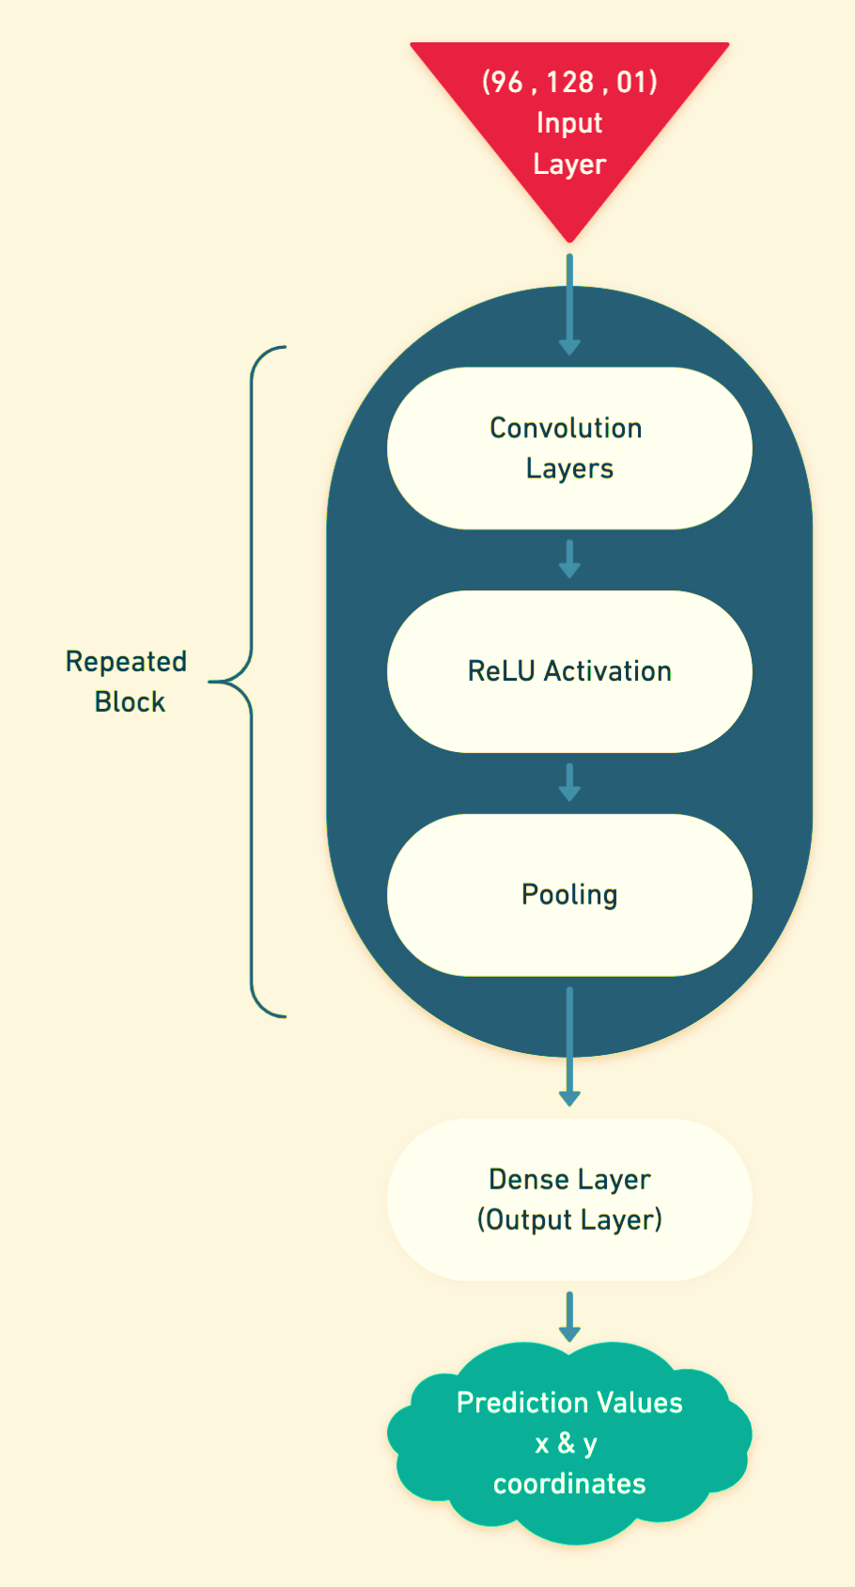
2. Network Architecture
Input Layer
Image resolution of 128 x 96 px
2D Convolutions with ReLU Activations
Generalize positional information
Pooling layers
Parameter reduction
Dense Layer
Output shape of 2 (x,y-coordinates)

Slide 8
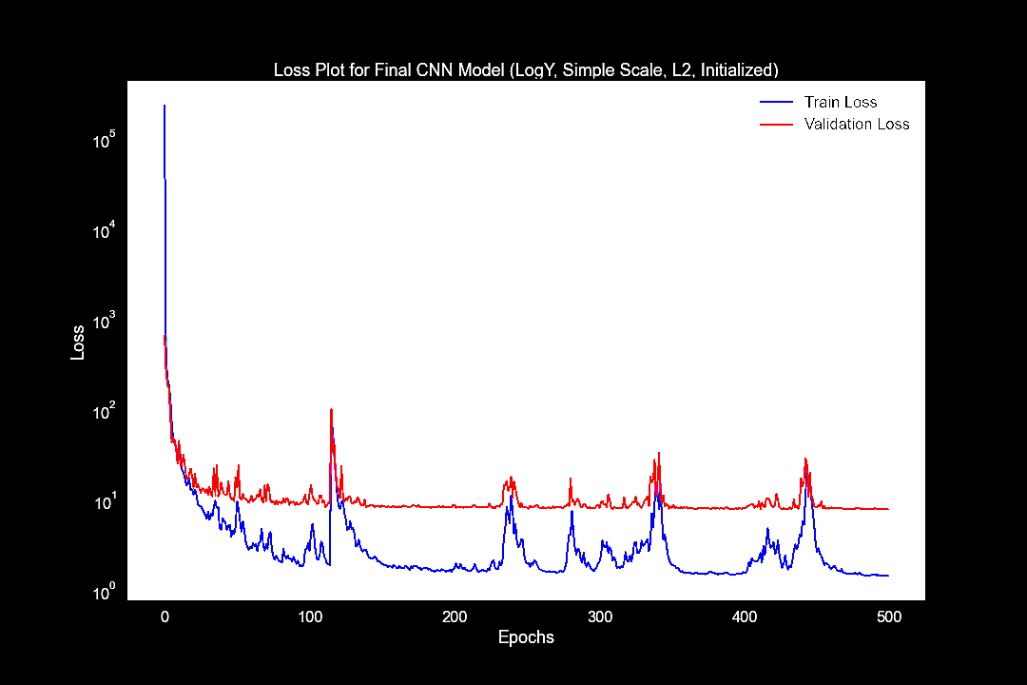
3. Results (Using MSE)
Hyperparameters
500 epochs
L2 Regularization
He Normal Initialization
5x5 kernel for input layer
3x3 Kernel for remaining
layers
Issues
Overfitting
Model isn’t generalizing and has memorized the dataset provided

Slide 9
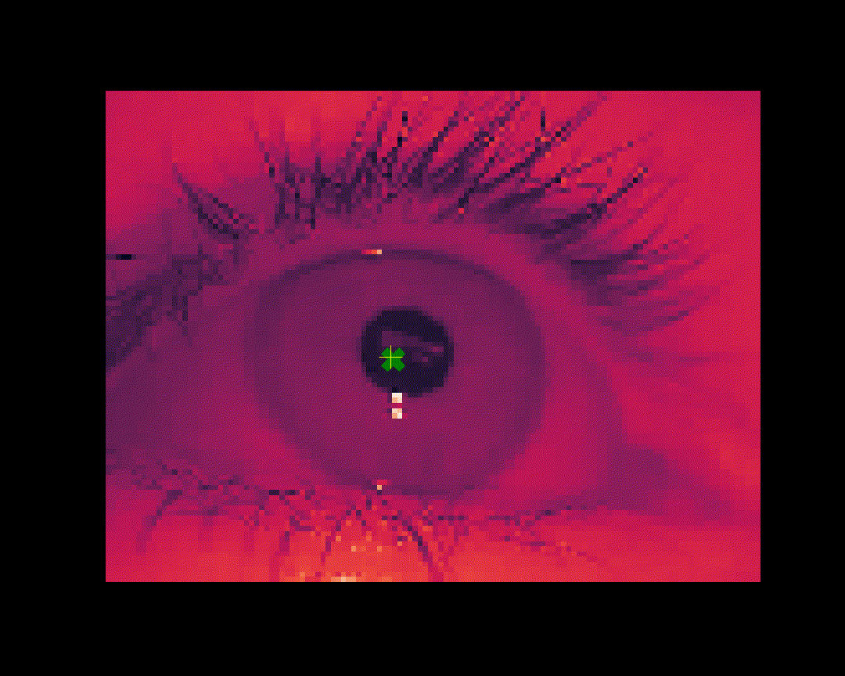
Keypoints: Predicted vs Labeled
Model Prediction
Yellow ‘+’
===========
Keypoint
Dataset Label
Green ‘X’

Slide 10
Next Steps…
Model deployment
Web application to take image capture
Outputs image with predicted keypoint
Model retraining for better results
Generalize gaze-tracking to lower resolutions using face recognition
Onwards to other milestones…
Identify gaze vector
Object detection and recognition

Slide 11
Tech Stack
Keras
CNN architecture
Model training
OpenCV, ffmpeg
Image preprocessing and visualizations
Pandas, Numpy
Data manipulation and reshaping for model fitting
Xarray
To work with multi-indexed data
Matplotlib, Seaborn
Plotting and graph visuals
Scikit-Learn
Validation and testing

Slide 12
Dataset Reference
Labelled pupils in the wild: A dataset for studying pupil detection in unconstrained environments
Marc Tonsen, Xucong Zhang, Yusuke Sugano, Andreas Bulling
Proc. of the 9th ACM International Symposium on Eye Tracking Research & Applications (ETRA 2016), 2016
DOI Information

